Slide 1
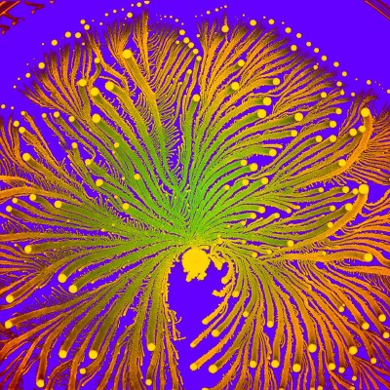
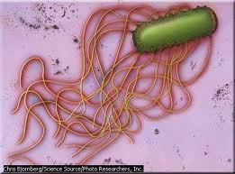
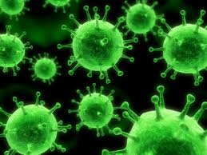
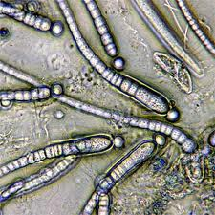
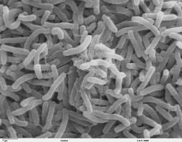
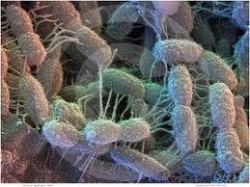
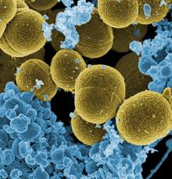
  Infectious Diseases
  Lesson 1.4

Slide 2
Lesson Objectives:
After finishing today’s lesson, you will be able to:
describe the relative sizes of bacteria and viruses compared to a eukaryotic (host) cell.
name viral structures and describe their functions in viral infection.
describe the viral life cycle.

Slide 3
Do Now
How big do you think a virus is in comparison to a bacteria and to a red blood cell?
http://www.cellsalive.com/howbig.htm
http://htwins.net/scale2/

Slide 4
How big are microbes?
1 Eukaryotic cell can fit around 1,000 bacterial cells.
Why can a eukaryotic cell fit
1,000 bacterial cells instead
of only 10?
average size ~ 20 µm average size ~ 2 µm
Notes:
For simplicity of calculations each organism was represented as a cube with the side that has the average size of the organism listed above.
Average size of a virus: ~ 100 nm (0.1 µm)
Average size of a bacteria: ~ 2 µm
Average size of an eukaryotic cell: ~ 20 µm

Slide 5
How big are microbes?
1 bacterial cell can fit around 8,000 viruses.
average size ~ 2 µm average size ~ 0.1 µm (100 nm)
Why can a bacterial cell fit 8,000 viruses
instead of only 20?
Notes:
For simplicity of calculations each organism was represented as a cube with the side that has the average size of the organism listed above.
Average size of a virus: ~ 100 nm (0.1 µm)
Average size of a bacteria: ~ 2 µm
Average size of an eukaryotic cell: ~ 20 µm

Slide 6
How big are microbes?
1 eukaryotic cell : 1,000 bacteria : 8,000,000 viruses!
~ 20 µm ~ 2 µm ~ 0.1 µm
Notes:
For simplicity of calculations each organism was represented as a cube with the side that has the average size of the organism listed above.
Average size of a virus: ~ 100 nm (0.1 µm)
Average size of a bacteria: ~ 2 µm
Average size of an eukaryotic cell: ~ 20 µm

Slide 7
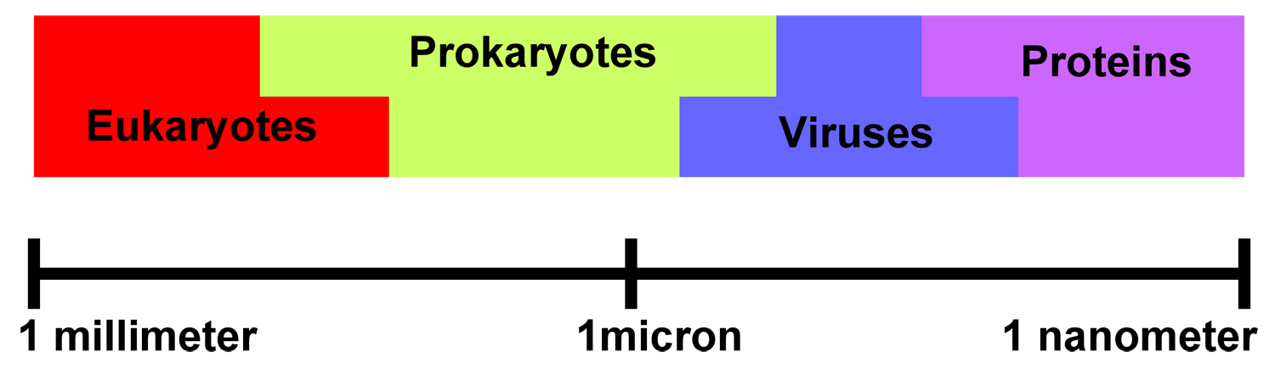
The sizes of different types of cells overlap
There are a 1,000 microns in a millimeter
and a 1,000 nanometers in a micron.

Slide 8
What is a virus?
A small infectious agent that cannot reproduce on its own. Viruses need a host cell machinery to replicate.
What might a virus need to replicate?

Slide 9
The structure of viruses from the inside out
  The genome – where the genes are located.
  The capsid – a protein coat that covers the genome.
  The envelope – a lipid-protein coat that covers the capsid.
Viruses with just a genome and a capsid are called naked.
Viruses with a genome, capsid and an envelope are called enveloped.

Slide 10
The structure of viruses from the inside out
Naked:
Enveloped:
envelope
A genome (behind the pink layer) surrounded by a capsid (in pink).
A genome surrounded by a capsid.
The capsid is surrounded by an envelope.

Slide 11
The Genome
Is inside the capsid.
Can be DNA or RNA.
Codes for viral proteins.
Naked
Enveloped
Genome
Genome

Slide 12
The Capsid
Protects the genome.
Composed of protein.
Contains enzymes needed for replication.
Naked
Enveloped
Capsid
Capsid

Slide 13
The Envelope
Protects the capsid when present.
Composed of protein and lipid.
Contains proteins needed to attach to host cells.
Naked
Enveloped
Envelope
No envelope

Slide 14
Viral Life Cycle
The virus attaches to its host cell.
The virus enters its host cell.
The virus hijacks the host cell so it can replicate.
The new viruses exit the host cell.
How depends on whether the virus is naked or enveloped

Slide 15
How NAKED viruses enter host cells
The naked virus might inject their genome through the host cell membrane: for example, viruses that infect bacteria (bacteriophages).
The naked virus might be taken
up by endocytosis and
then punch holes in the endosome
membrane: for example, polio virus.
Cell membrane
Nucleus
Capsid & Genome
Once the genome is in the cell
it can begin to replicate.

Slide 16
How ENVELOPED viruses enter host cells
Cell membrane
Because the enveloped virus also
has a membrane it might fuse
with the host cell membrane:
for example, HIV
The enveloped virus might be taken
up by endocytosis and then fuse
with the endosome membrane:
for example, H1N1
Nucleus
Once the genome is in the cell
it can begin to replicate.

Slide 17
How NAKED viruses exit host cells
The host cell fills with mature viruses and bursts. This is called lysis.
Mature viruses
Even bacteria can be infected by viruses!
This is a naked virus, called Bacteriophage, that infects bacteria.

Slide 18
How ENVELOPED viruses exit host cells
The new envelope proteins are collected in the host cell membrane.
The new capsid proteins and the genome collect below the envelope proteins.
The new enveloped virus forms and buds off from the host cell.
The new virus buds off the membrane
The capsid pushes out and picks up envelope

Slide 19
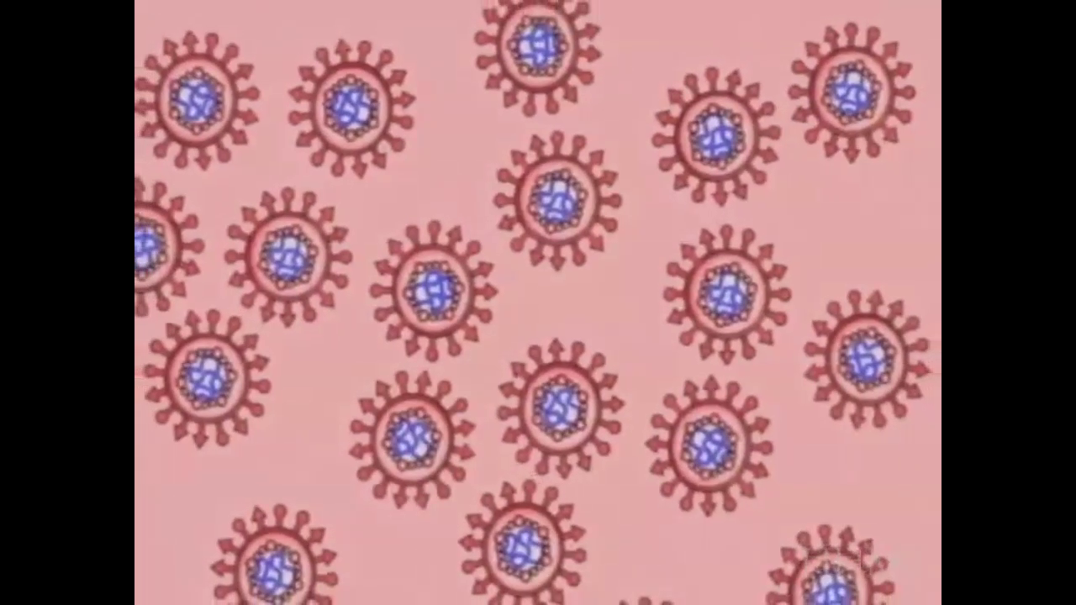
Let’s put this all together!

Slide 20
Homework
  Complete the Venn Diagram worksheet.

